Slide 1
Group 3 Project Presentation
Abdullah, Sayed, Zenawi, Quentin, Austin

Slide 2
Project Description
Design an instrumentation package that will be placed in a remote location for up to seven days to sample relevant data to support a hypothesis.
Hypothesis: As UV light increases, ground moisture, and air humidity will both decrease.
Team Assignment:
Abdullah → Main program and Data logging
Austin → Packaging and Moisture Sensor
Quentin → Hardware and PCB Design
Sayed → UV light and Humidity Sensors
Zenawi → Power Requirements

Slide 3
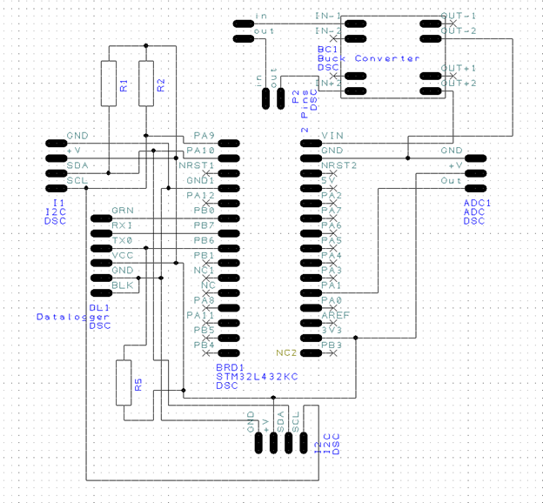
Hardware Design
~ 2 ADC Channel pins
~ UART 1
~ I2C 1 - PA9 & PA10

Slide 4
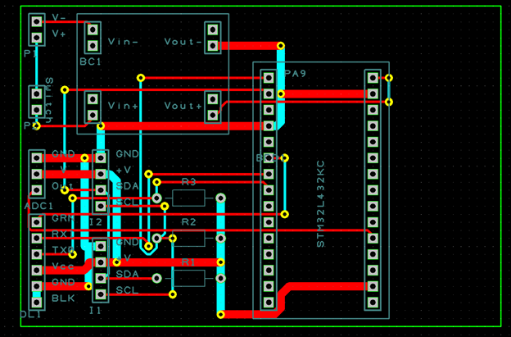
Hardware Design

Slide 5
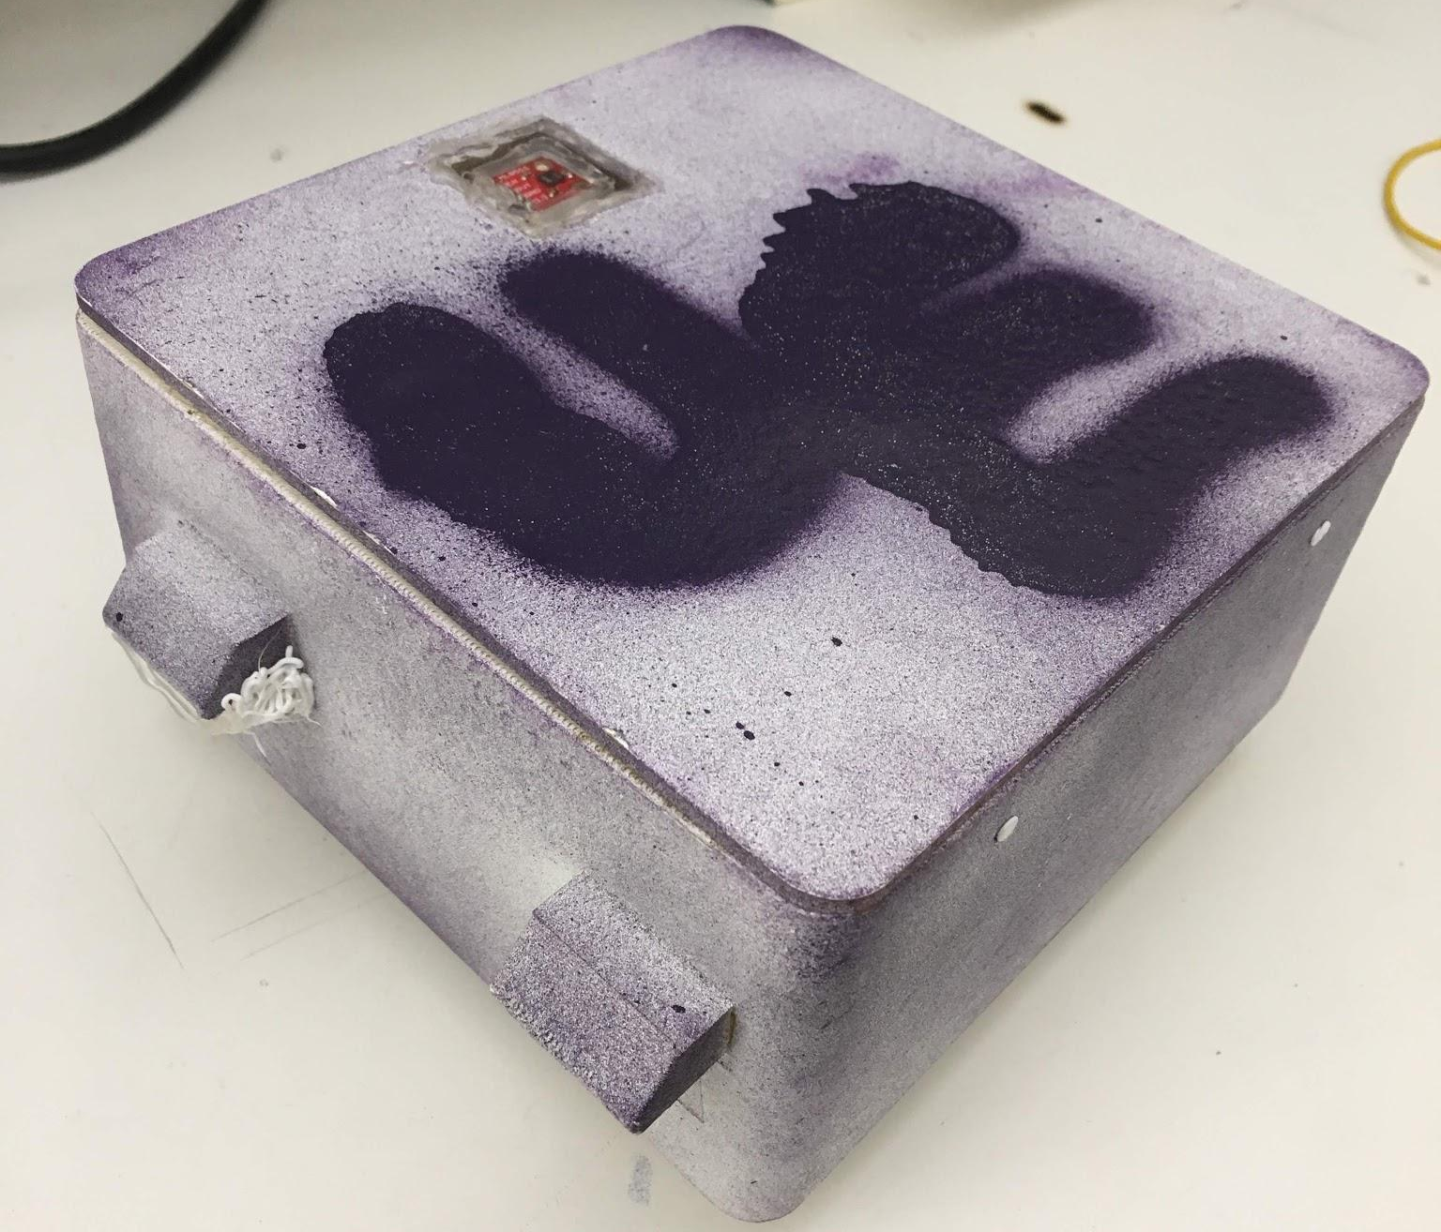
Packaging
~ 3D - Printed Design
~ New UE Logo
~ Flex Sealed to waterproof
~ Sensor accessibility

Slide 6
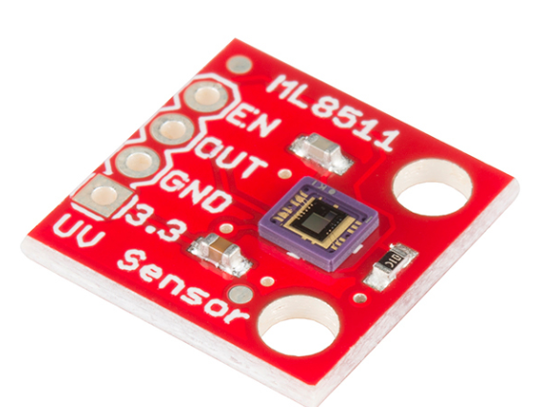
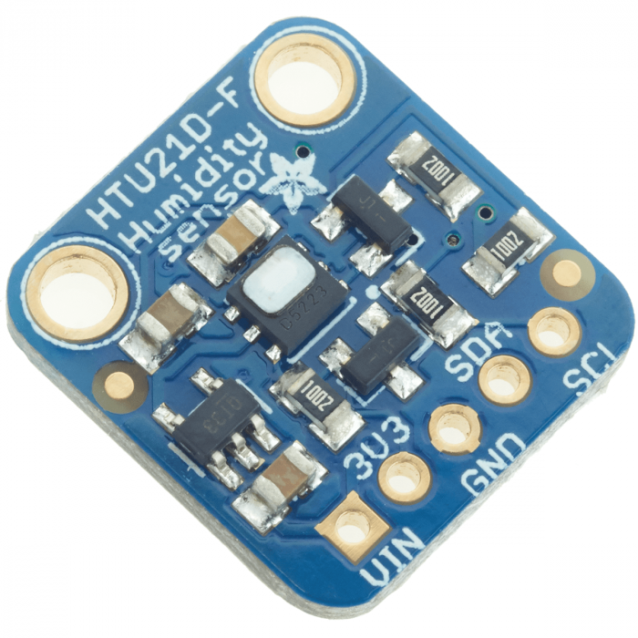
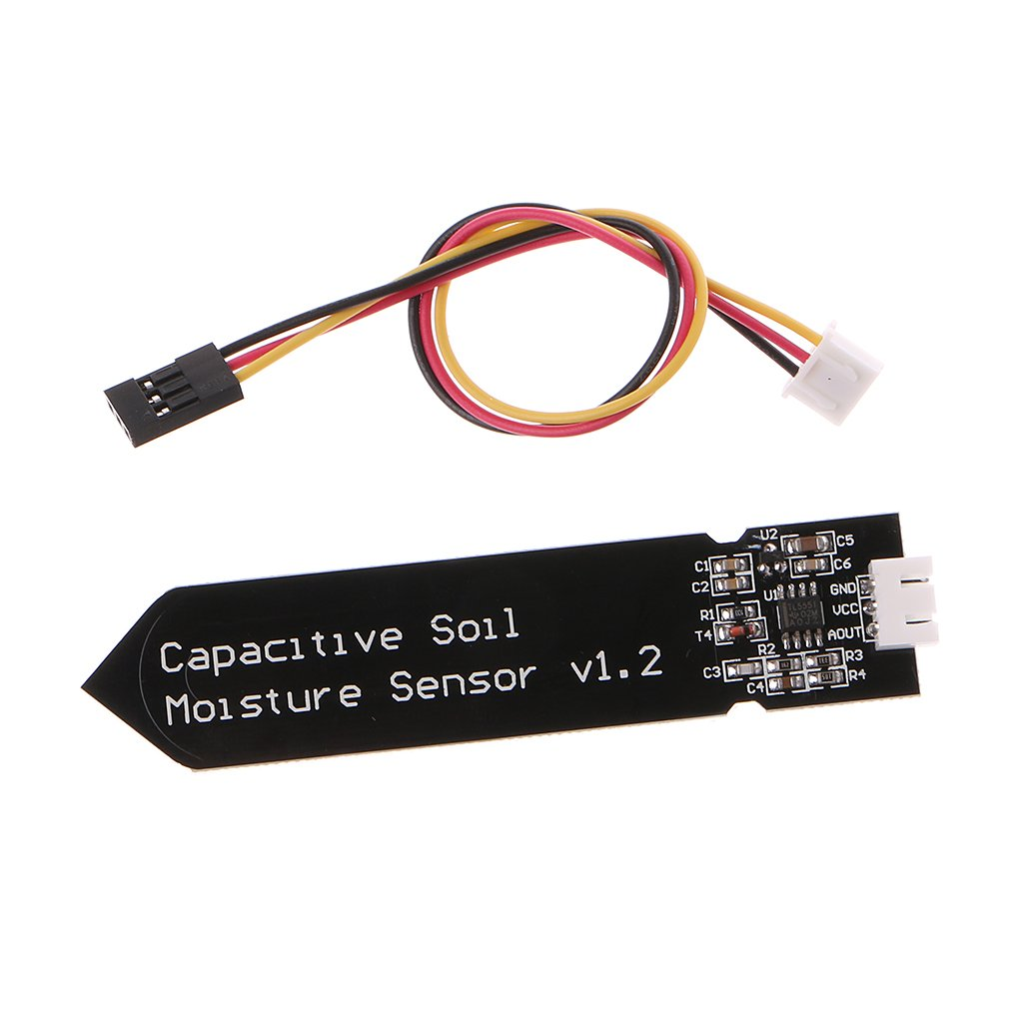
Sensors Used:
Temperature and humidity (I2C)
UV Light (ADC)
Ground Moisture (ADC)

Slide 7
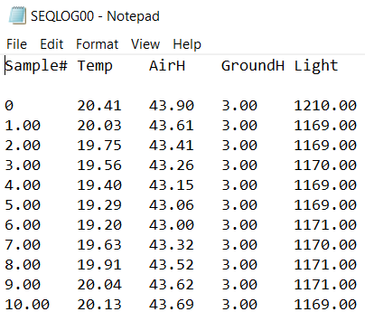
Data Logging
~ Data logger was set in sequential mode where new data was appended to the same file
~ The data was organized in a table for easy extraction
~ Used a timer to record data every 10 minutes
~ Polling
~ No infinite loops

Slide 8
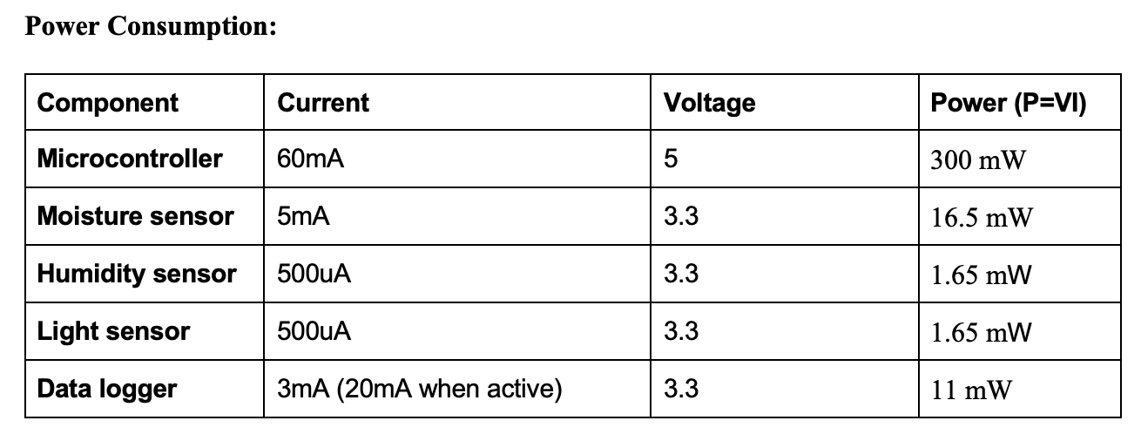
Power Requirements
To find out the operating current of the devices, we used datasheets and multimeter
Total power consumption = 330.8 mW

Slide 9
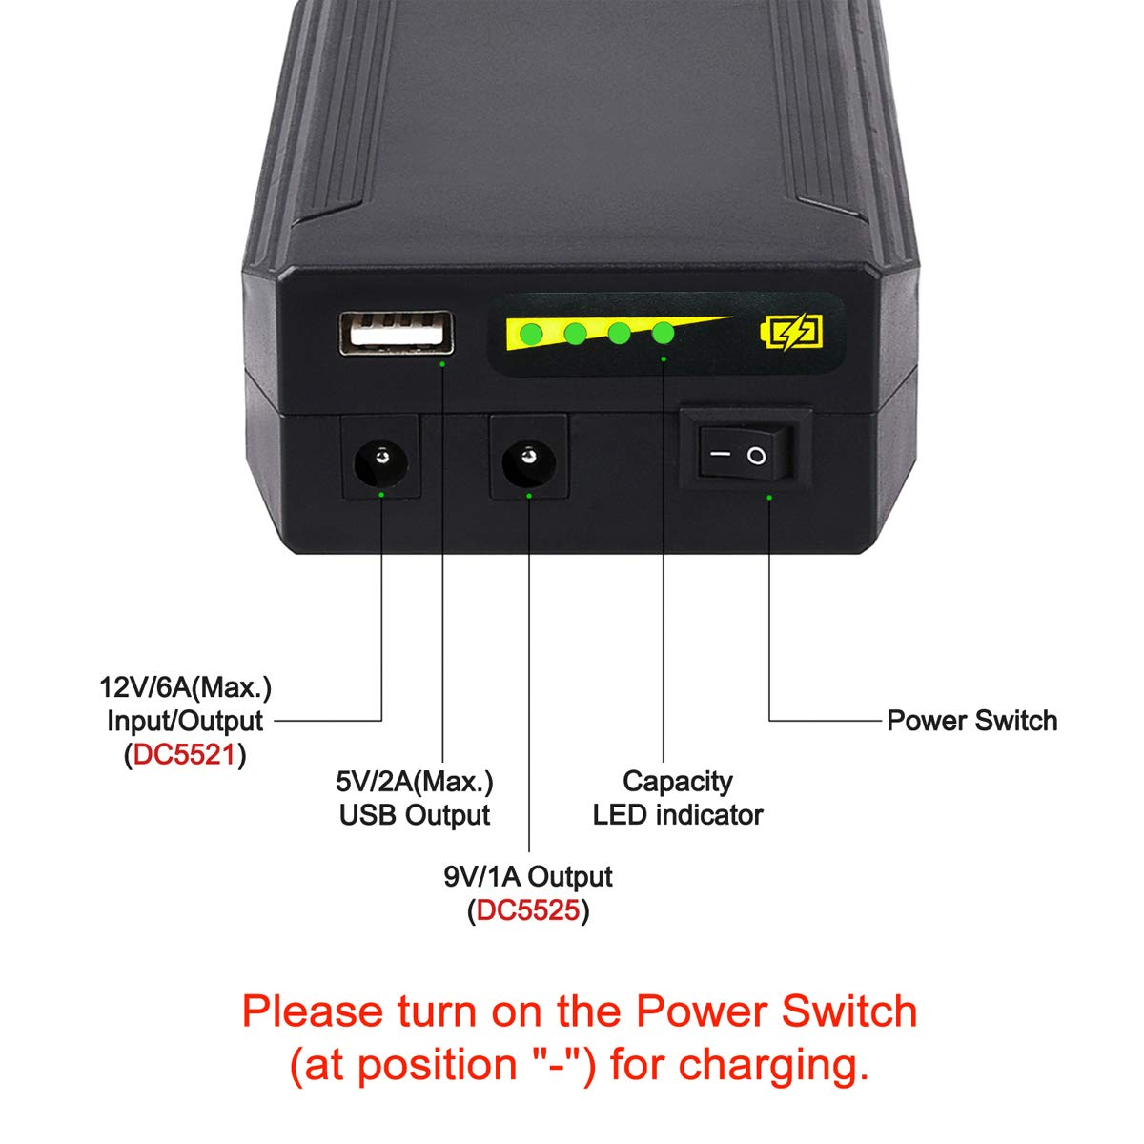
Power Considerations
First, I looked into minimizing power consumption of our circuit
  Low power mode
  Reducing clock speed
  turning off on-board LEDs of the microcontroller
Later, decided to use Power Bank to ensure enough power supply for at least a week

Slide 10
